Slide 1
Blacktown Chinese Christian Church
Welcome to Our English Service 23.02.2025
English Service 9:45 – 11:00 am
Worship Songs: Passage: Speaker: Topic: Response Song: Announcements and Closing Prayer Benediction
Even When It Hurts In Control Be Thou My Vision (Ascend The Hill) Job 1:6-22 TBA TBA TBA

Slide 2
BCCC english service

Slide 3

Please keep all phones on silent

Slide 4
Even When It Hurts
Joel Houston © 2015 Hillsong Music Publishing Australia CCLI Licence No. 5485849. CCLI Song number: 7037924

Slide 5
Verse 1
Take this fainted heart
Take these tainted hands
Wash me in Your love
Come like grace again

Slide 6
Chorus
Even when my strength is lost
I'll praise You
Even when I have no song
I'll praise You

Slide 7
Chorus
Even when it's hard to find the words
Louder then I'll sing Your praise

Slide 8
Verse 2
Take this mountain weight
Take these ocean tears
Hold me through the trial
Come like hope again

Slide 9
Chorus 2
Even when the fight seems lost
I'll praise You
Even when it hurts like hell
I'll praise You

Slide 10
Chorus 2
Even when it makes no sense to sing
Louder then I'll sing Your praise

Slide 11
Post-Chorus
I will only sing Your praise
I will only sing Your praise
I will only sing Your praise

Slide 12
Bridge 1
And my heart burns only for You
You are all, You are all I want
And my soul waits only for You
And I will sing till the morning has come

Slide 13
Bridge 2
Lord my heart burns only for You
You are all, You are all I want
And my soul waits only for You
I will sing till the miracle comes

Slide 14
Post-Chorus
I will only sing Your praise
I will only sing Your praise
I will only sing Your praise

Slide 15
Chorus 3
Even when the morning comes
I'll praise You
Even when the fight is won
I'll praise You

Slide 16
Chorus 3
Even when my time on earth is done
Louder then I'll sing your praise
I will only sing Your praise

Slide 17
In Control
Aodhan King, Ben Fielding ©2016 Hillsong Music Publishing Australia CCLI Licence No. 5485849. CCLI Song number: 7068425

Slide 18
Verse 1
From Heaven, You can hear
I know You're drawing near
As I worship

Slide 19
Verse 1
Held within Your love
The wind and waves will come
But I will stay here

Slide 20
Chorus
I lift my hands to Heaven
Here my heart surrendered
I tell my soul again
You are Lord of all

Slide 21
Chorus
And though the seas are raging
You will speak and tame them
In You, I find my rest
You are in control

Slide 22
Verse 2
Through valleys, I will trust
Your spirit is enough, to keep me walking
You guide my every step

Slide 23
Verse 2
Speak life to me again
Lord, I need You
Oh I need You

Slide 24
Chorus
I lift my hands to Heaven
Here my heart surrendered
I tell my soul again
You are Lord of all

Slide 25
Chorus
And though the seas are raging
You will speak and tame them
In You, I find my rest
You are in control

Slide 26
Bridge
I will trust in only You
No one can add to Your perfection

Slide 27
Bridge
You're the beginning and the end
More than I can comprehend
There is no one like You
No one

Slide 28
Bridge
I will trust in only You
No one can add to Your perfection

Slide 29
Bridge
You're the beginning and the end
More than I can comprehend
There is no one like You
No one

Slide 30
Bridge
I will trust in only You
No one can add to Your perfection

Slide 31
Bridge
You're the beginning and the end
More than I can comprehend
There is no one like You
No one

Slide 32
Chorus
I lift my hands to Heaven
Here my heart surrendered
I tell my soul again
You are Lord of all

Slide 33
Chorus
And though the seas are raging
You will speak and tame them
In You, I find my rest
You are in control

Slide 34
Chorus
I lift my hands to Heaven
Here my heart surrendered
I tell my soul again
You are Lord of all

Slide 35
Chorus
And though the seas are raging
You will speak and tame them
In You, I find my rest
You are in control

Slide 36
Outro
In You, I find my rest
You are in control

Slide 37
Be Thou My Vision (Ascend The Hill)
Eleanor Henrietta Hull, Mary Elizabeth Byrne © Words: Public Domain Music: Public Domain CCLI Licence No. 5485849 . CCLI Song number: 30639

Slide 38
Verse 1
Be Thou my Vision, O Lord of my heart
Naught be all else to me, save that Thou art
Thou my best Thought, by day or by night
Waking or sleeping, Thy presence my light

Slide 39
Verse 2
Be Thou my Wisdom, and Thou my true Word
I ever with Thee and Thou with me, Lord
Thou my great Father, I Thy true son
Thou in me dwelling, and I with Thee one

Slide 40
Verse 3
Riches I heed not, nor man's empty praise
Thou mine Inheritance, now and always
Thou and Thou only, put first in my heart
High King of Heaven, my Treasure Thou art

Slide 41
Chorus
Oh, God, be my everything, be my delight
Be, Jesus, my glory My soul's satisfied (x2)

Slide 42
Verse 4
High King of Heaven, my victory won
May I reach Heaven's joys, bright Heaven's Sun!
Heart of my own heart, whatever befall
Still be my Vision, O Ruler of all

Slide 43

Bible reading

Slide 44
Job 1:6-22 (NIV)
⁶ One day the angels came to present themselves before the Lord, and Satan also came with them. ⁷ The Lord said to Satan, “Where have you come from?”
Satan answered the Lord, “From roaming throughout the earth, going back and forth on it.”

Slide 45
Job 1:6-22 (NIV)
⁸ Then the Lord said to Satan, “Have you considered my servant Job? There is no one on earth like him; he is blameless and upright, a man who fears God and shuns evil.”
⁹ “Does Job fear God for nothing?” Satan replied.

Slide 46
Job 1:6-22 (NIV)
¹⁰ “Have you not put a hedge around him and his household and everything he has? You have blessed the work of his hands, so that his flocks and herds are spread throughout the land. ¹¹ But now stretch out your hand and strike everything he has, and he will surely curse you to your face.”

Slide 47
Job 1:6-22 (NIV)
¹² The Lord said to Satan, “Very well, then, everything he has is in your power, but on the man himself do not lay a finger.”
Then Satan went out from the presence of the Lord.
¹³ One day when Job’s sons and daughters were feasting and drinking wine at the oldest brother’s house,

Slide 48
Job 1:6-22 (NIV)
¹⁴ a messenger came to Job and said, “The oxen were plowing and the donkeys were grazing nearby, ¹⁵ and the Sabeans attacked and made off with them. They put the servants to the sword, and I am the only one who has escaped to tell you!”

Slide 49
Job 1:6-22 (NIV)
¹⁶ While he was still speaking, another messenger came and said, “The fire of God fell from the heavens and burned up the sheep and the servants, and I am the only one who has escaped to tell you!”
¹⁷ While he was still speaking, another messenger came and said, “The Chaldeans formed three raiding parties and swept down on your camels and made off with them. They put the servants to the sword, and I am the only one who has escaped to tell you!”

Slide 50
Job 1:6-22 (NIV)
¹⁸ While he was still speaking, yet another messenger came and said, “Your sons and daughters were feasting and drinking wine at the oldest brother’s house, ¹⁹ when suddenly a mighty wind swept in from the desert and struck the four corners of the house. It collapsed on them and they are dead, and I am the only one who has escaped to tell you!”

Slide 51
Job 1:6-22 (NIV)
²⁰ At this, Job got up and tore his robe and shaved his head. Then he fell to the ground in worship ²¹ and said:
“Naked I came from my mother’s womb,
and naked I will depart.
The Lord gave and the Lord has taken away;
may the name of the Lord be praised.”

Slide 52
Job 1:6-22 (NIV)
²² In all this, Job did not sin by charging God with wrongdoing.

Slide 53
Scripture quotations taken from The Holy Bible, New International Version® NIV®
Copyright © 1973, 1978, 1984, 2011 by Biblica, Inc.
Used with permission. All rights reserved worldwide.

Slide 54
Announcements

Slide 55





Account name: Blacktown Chinese Christian Church
Account number: 4216 50263
Offering
BSB: 112 - 879
Please put in "offering" as the reference
The offering box is available at the back of the hall

Slide 56
Prayer points

Slide 57
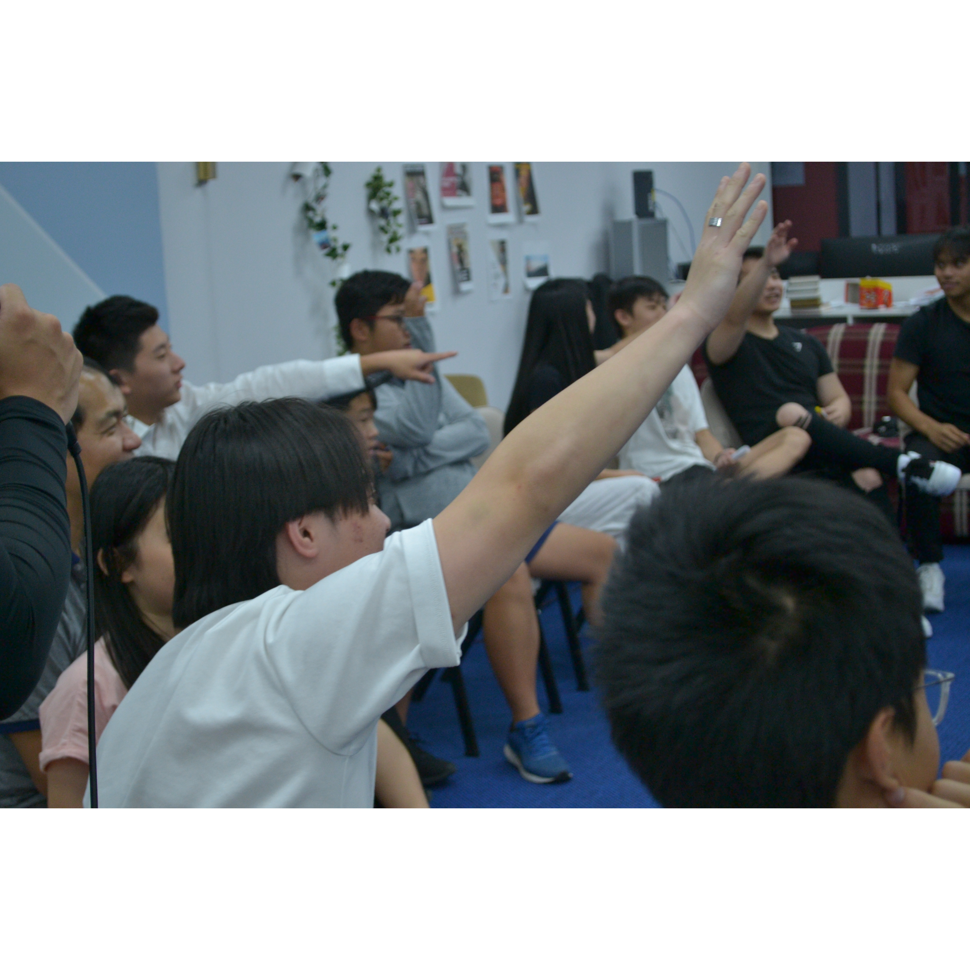
Mingle time!

